Slide 2
Aim
I can describe a diverse society and talk about why it is important.
Success Criteria
I can interpret a diversity data table.
I can write a poem to explain and celebrate diversity.
I can identify ways to show respect to others.
I can discuss why showing respect and being tolerant is important
I can explain what discrimination is, can describe behaviour which is prejudiced and know what to do if I see it happening.

Slide 3

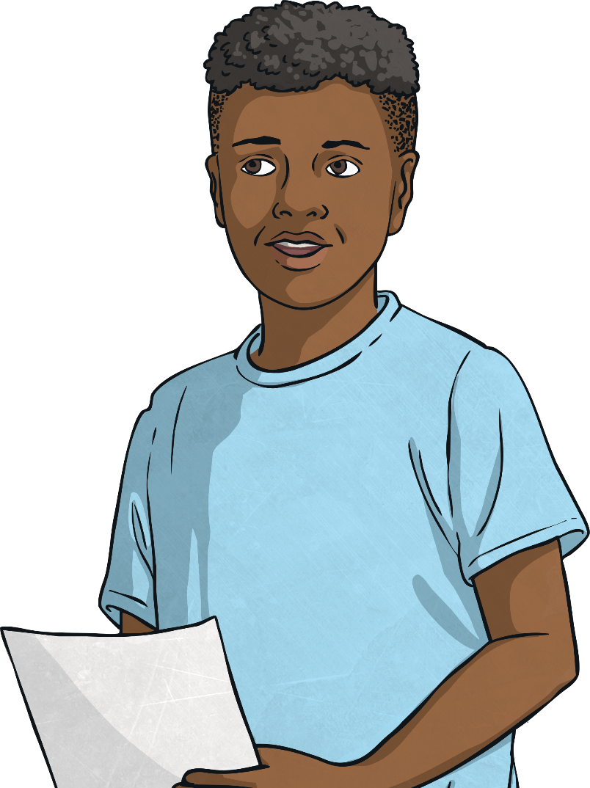
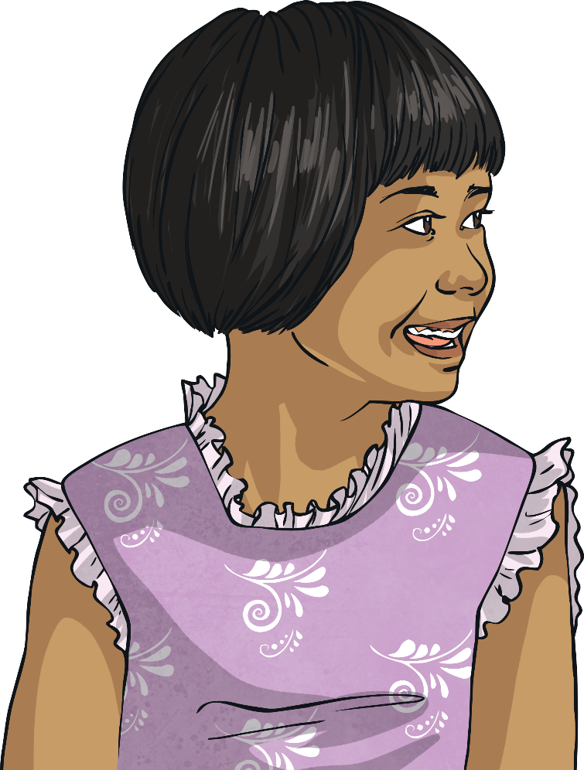
Why should we be respectful of others?
What is diversity and why is it important?

Slide 4

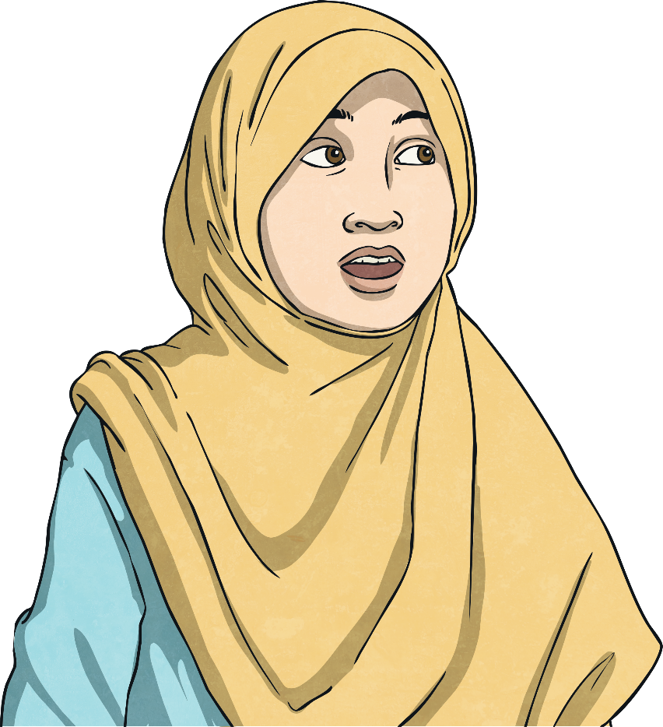
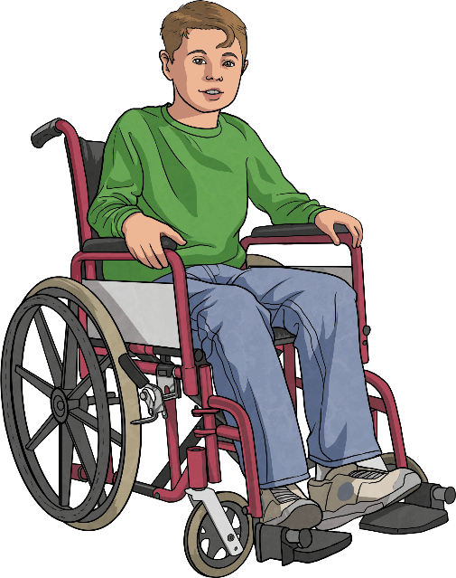
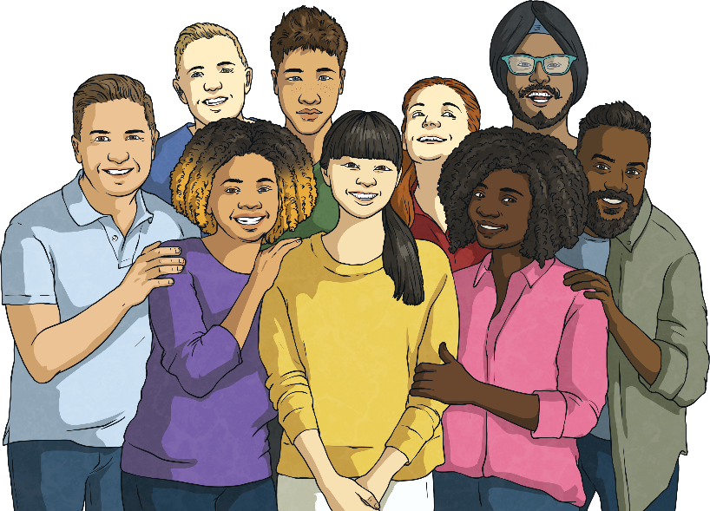
Diversity
Diverse means a wide variety.
Society means a community where people are living together.
So, in what ways can a society be diverse?
Share your thoughts with a partner. You can use the pictures to help you.
Now, share your ideas with the whole class.

Slide 5

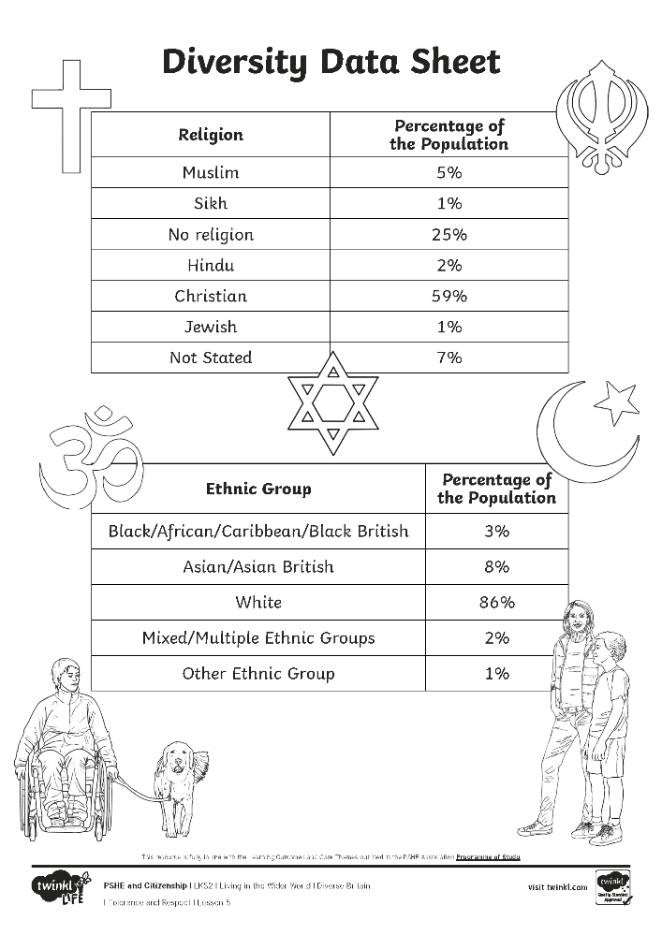
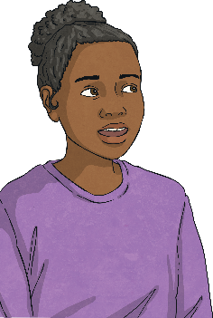
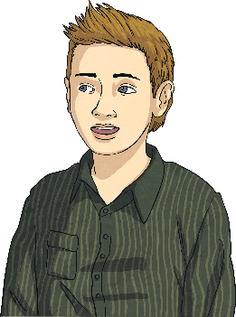
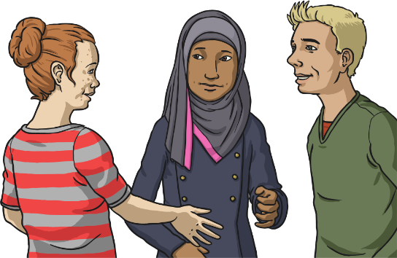
Diverse Britain
Britain and other British Isles are diverse societies because there is a variety of people from different ethnic groups and religions.
People who live in Britain and other British Isles come from lots of different ethnic, religious and cultural backgrounds. We are fortunate to live in a diverse society.
Here are two data tables which show the range of identities of people living in Britain.

Slide 6
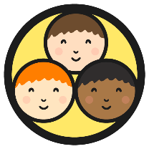
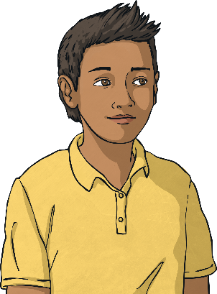
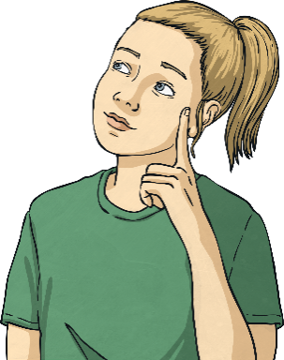
Diverse Britain
What do the data tables tell us about the diversity within Britain?
Look carefully at both Diversity Data Tables with your group. Using your coloured pens, write your answers to these questions on your piece of paper.
Which different religions can
be found in Britain and other
British Isles?
Which different ethnic groups
can be found in Britain and other British Isles?
Could there be any more religions that aren’t in the data table? Why? Can you think of any?
Could there be any more ethnic groups that aren’t in the data table? Why? Can you think of any?
What did you find out?
Share your findings with the class.

Slide 7
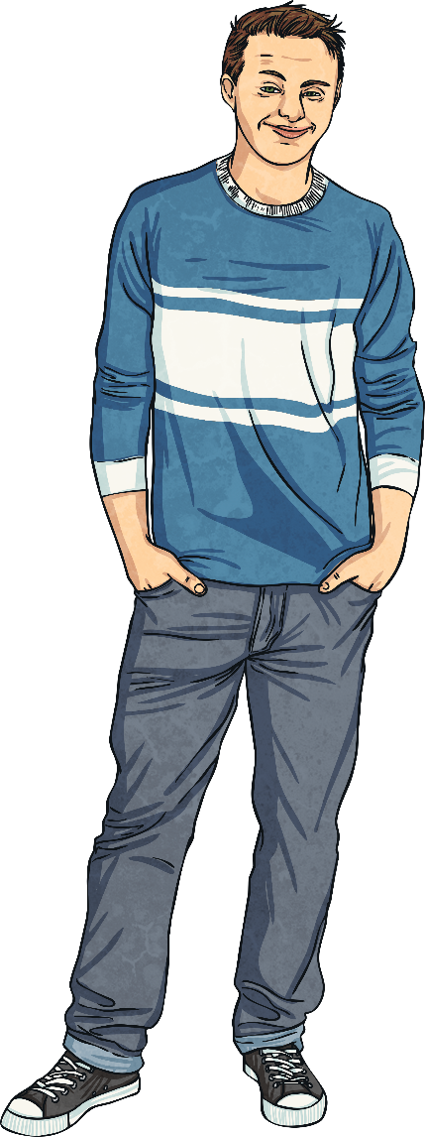
The Importance of Diversity
Why do you think diversity is important?
Diversity is important because it means we can spend time with, and learn new things about the world from, lots of different people.
It also helps us learn how to get along with people who are different to us, which can make the world a better place for everyone.
Diversity is important because differences make our communities and country strong and beautiful.
Consolidating
Reflecting

Slide 8

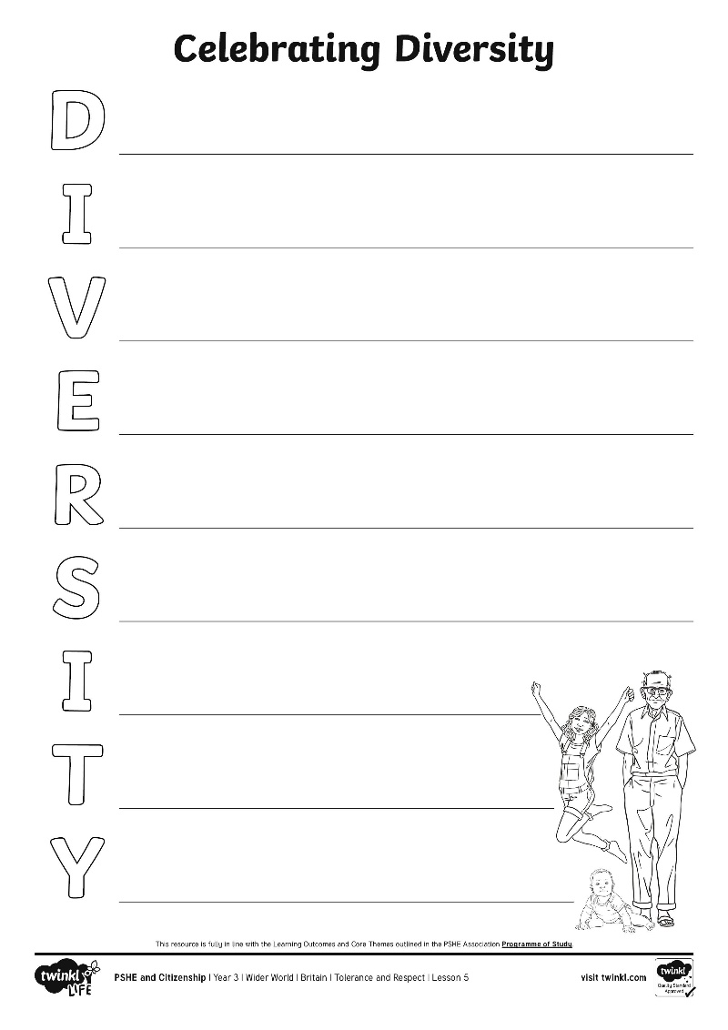
Celebrating Diversity
Diversity in the British Isles is something to be celebrated.
Write an acrostic poem to explain to others what diversity is and why it should be celebrated.
What could you include in your poem?
Word Bank:
different
nationality
ethnic
society
difference
celebrate
grow
learn
understanding
religious
respect
tolerance
exciting
beautiful
strong

Slide 9
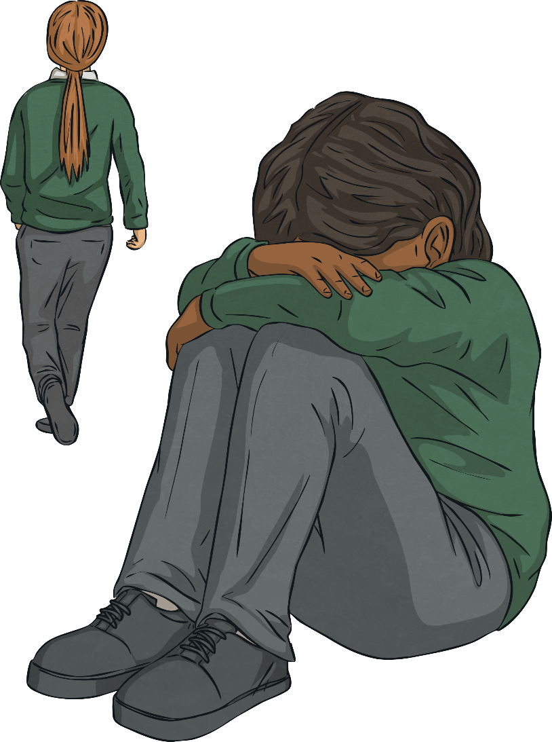
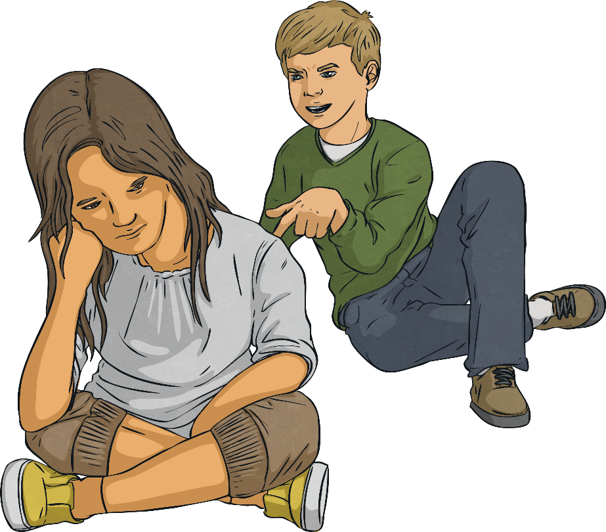
Being Respectful and Tolerant
We live in a diverse country; we are all different. Being respectful and tolerant of others can help make us all feel happier.
Unfortunately, in our country and throughout the world, people are sometimes treated unfairly and without respect by others because of differences between them. This is called discrimination and is often based on prejudiced thoughts and feelings, ones which are not based on truth or reason.
How does this make you feel?

Slide 10
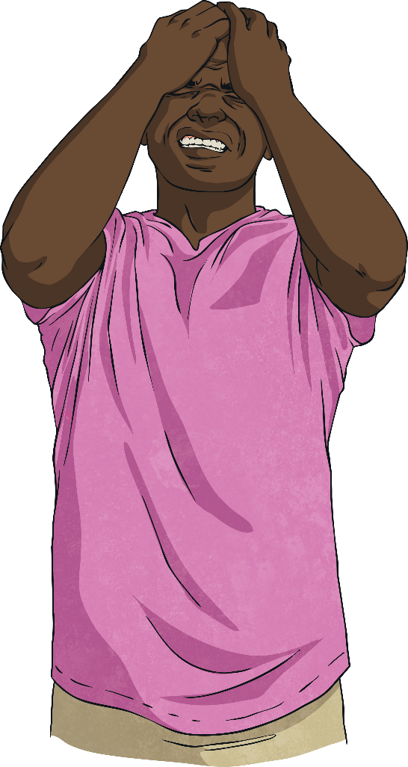

Being Respectful and Tolerant
This is unacceptable behaviour and is against British laws and rights. Discrimination and prejudice because of the differences between people can stop people being able to live a happy, safe, healthy and
fulfilling life.
What could we do if we see discrimination and prejudice happening?

Slide 11
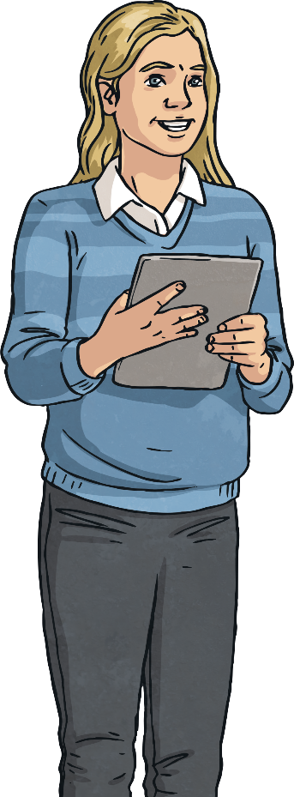
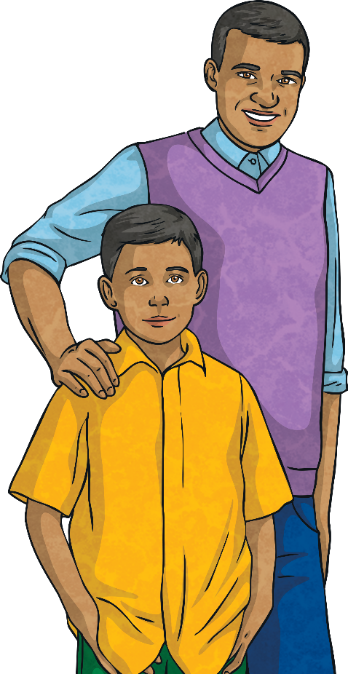
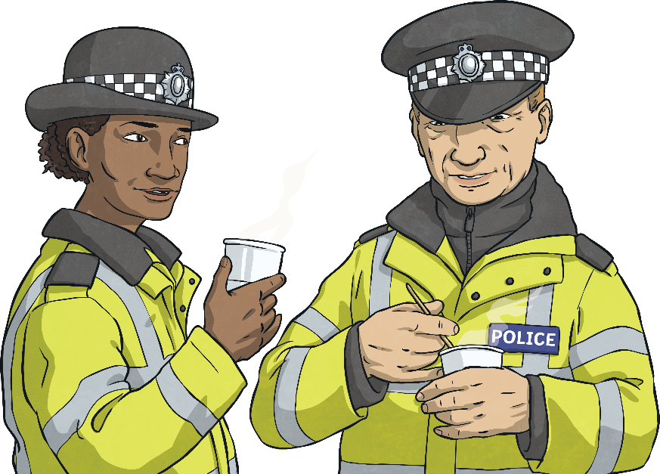
Being Respectful and Tolerant
It is important we live in a way which celebrates difference and makes sure we are treating all people fairly, with respect and kindness no matter who they are, where they are from, what they can or can’t do or how they choose to live their life.
If we see or experience behaviours which are not doing this, it is important to tell a trusted adult and ask for help to help make it stop.

Slide 12
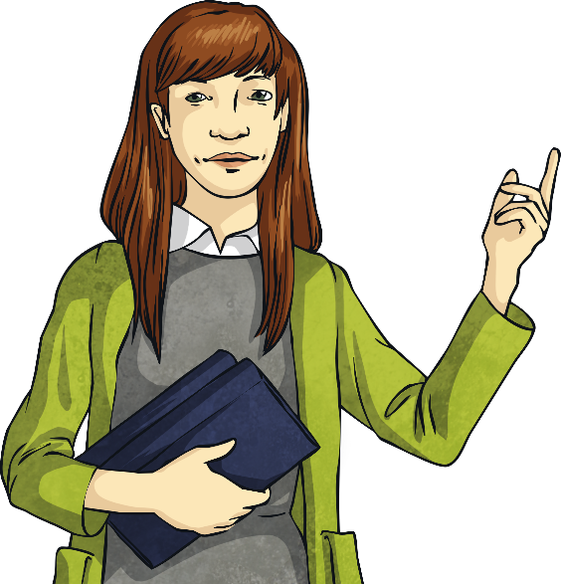
Being Respectful and Tolerant
Take a moment to think about your answer to this question:
How can I show respect to those who are different to me? Write your ideas on a sticky note.
What a lot of wonderful ideas! Let’s all make sure we do these in our daily school life and in our local community.
Let’s do our bit to make the world a happier, more accepting and tolerant place - helping all people live the life they deserve.

Slide 13
Why should we be respectful of others?
What is diversity and why is it important?
How could you use what you have learnt today in school?

Slide 14
Aim
I can describe a diverse society and talk about why it is important.
Success Criteria
I can interpret a diversity data table.
I can write a poem to explain and celebrate diversity.
I can identify ways to show respect to others.
I can discuss why showing respect and being tolerant is important
I can explain what discrimination is, can describe behaviour which is prejudiced and know what to do if I see it happening.

