Slide 1
L.O – To learn about different types of families

Slide 2
Aim
I can talk about my family and others’ families.
Success Criteria
I understand that there are many different types of families.
I can talk about similarities and differences between families.
I know who to tell if I have any worries about my family.

Slide 3
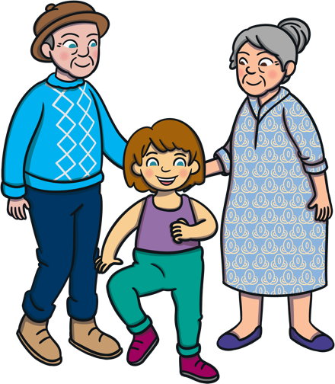

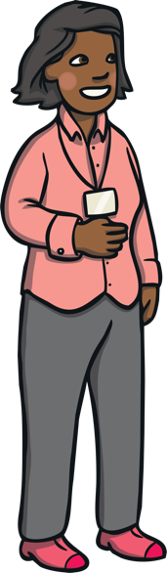
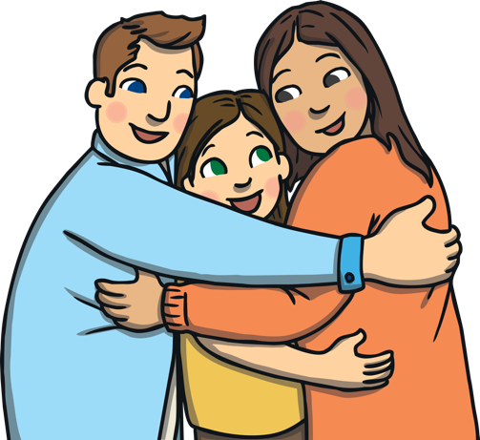
What is a family and what makes families special?
Who can I talk to if something about my family is worrying me?

Slide 4

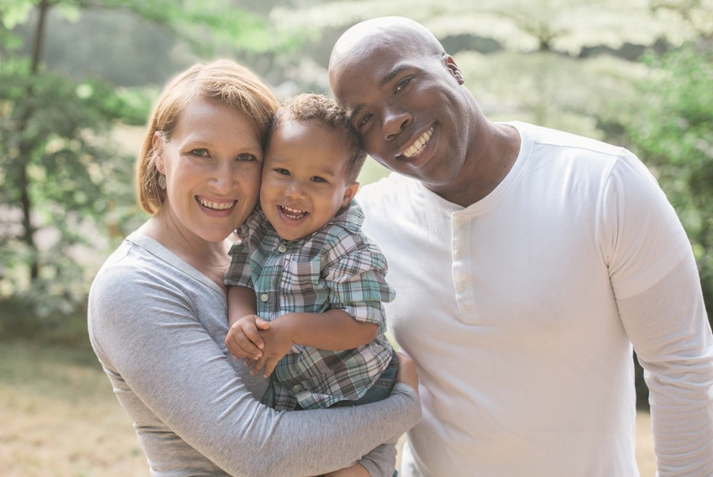
Who’s in a Family?
Which family members might be in this happy family photo?
mum
step-dad
uncle
niece
nephew
baby
dad
child
sister
step-mum
son
brother
daughter
auntie
carer

Slide 5
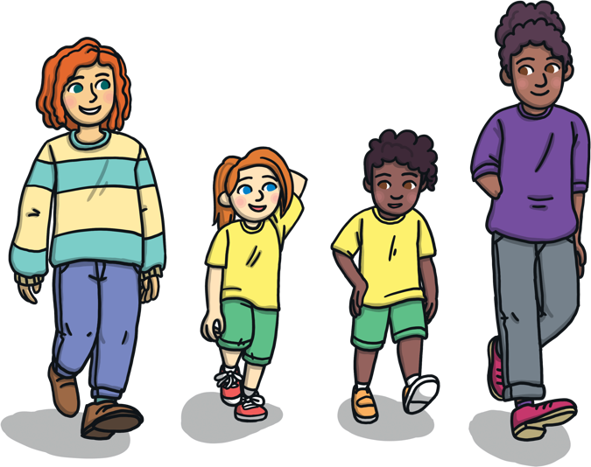
Who’s in a Family?
There are lots of different people that can be in a family.
One family might have different family members from another family.
Take turns in your group to tell each other who is in your family.
You can include the people you live with and other family members you visit.
Did anyone in your group describe a family that sounded a lot like yours?
Did you hear about different types of families as you listened to each other?

Slide 6

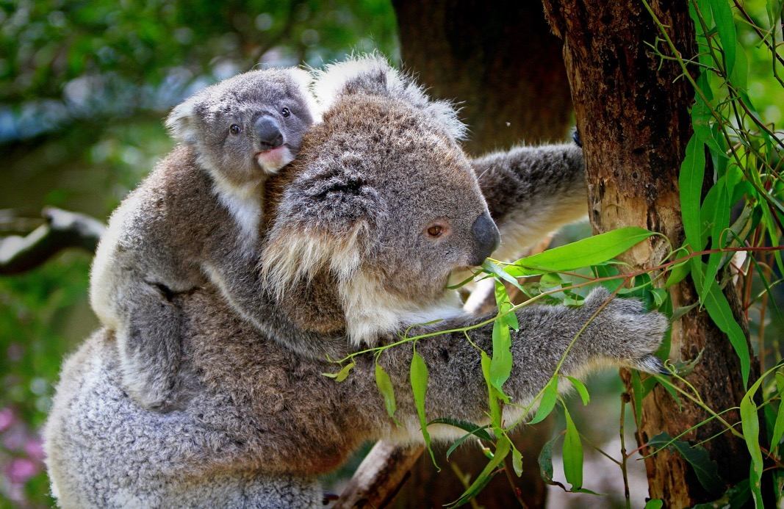
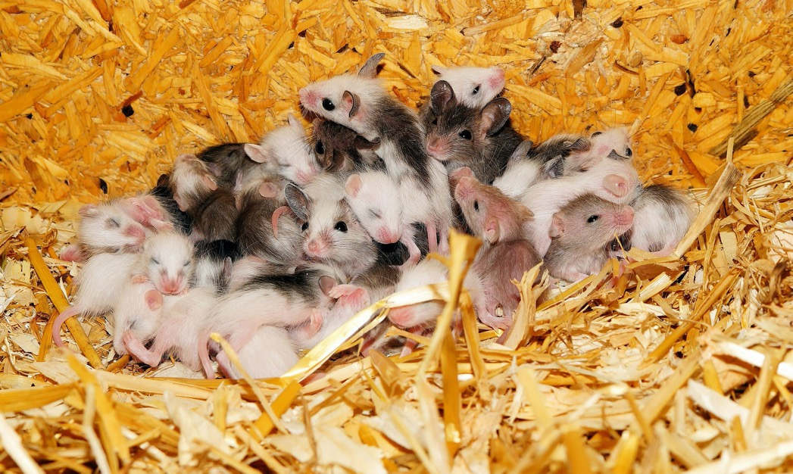
Different Families
… and families can be small.
Families can be large…

Slide 7
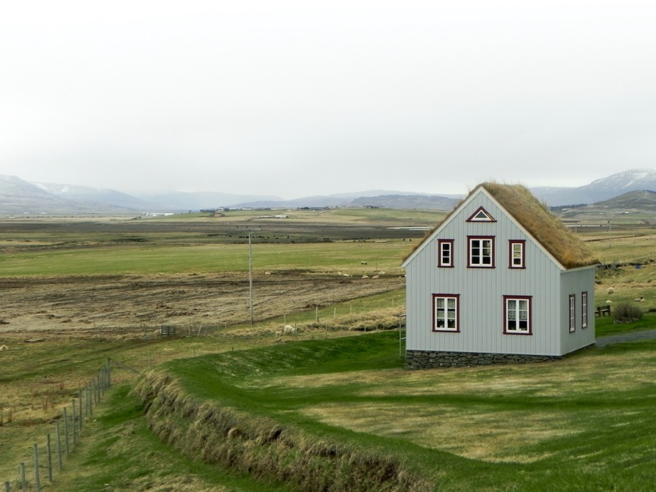

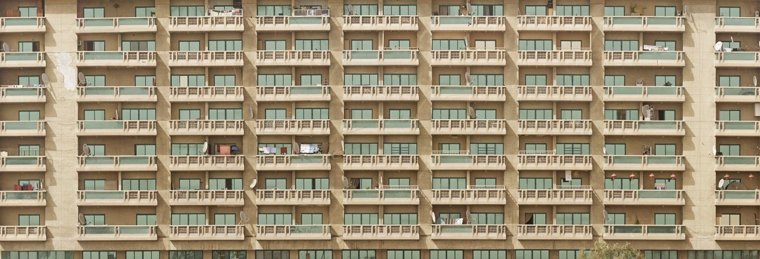
Different Families
Families live in all sorts of homes.

Slide 8
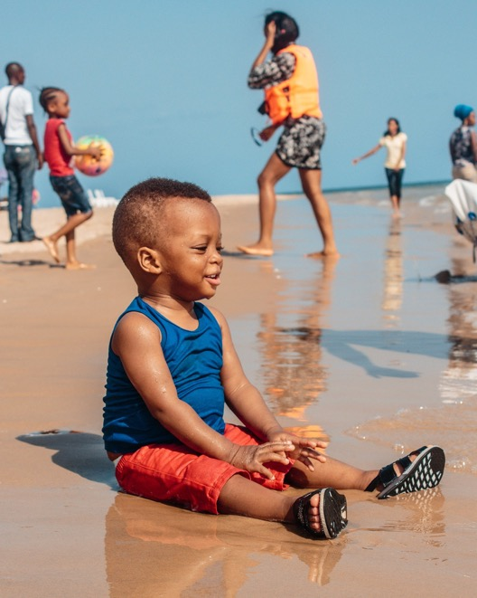
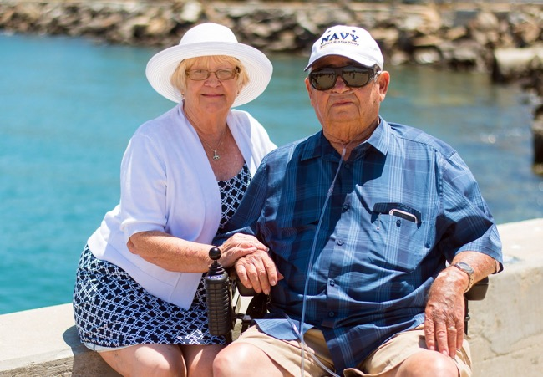
Different Families
There can be young family members...
...and older family members.

Slide 9
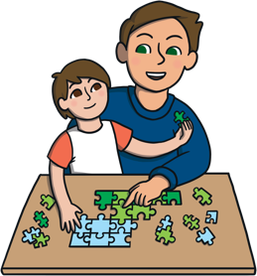


What Do Families Do?
watch films
play games
Can you think of some things
that lots of families might
do together?
Click the dots to reveal…
do jobs in
the house
learn new skills
grow plants
go on holiday
go shopping
share toys

Slide 10

What Do Families Do?
Families have fun together and laugh together.

Slide 11
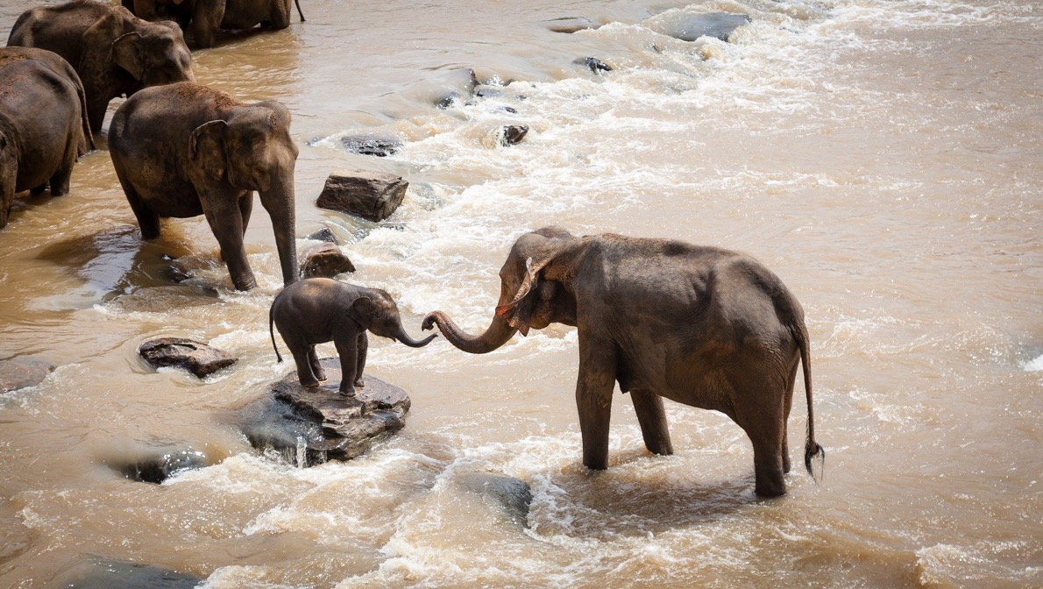
What Do Families Do?
Family members help each other and teach each other how to do things.

Slide 12
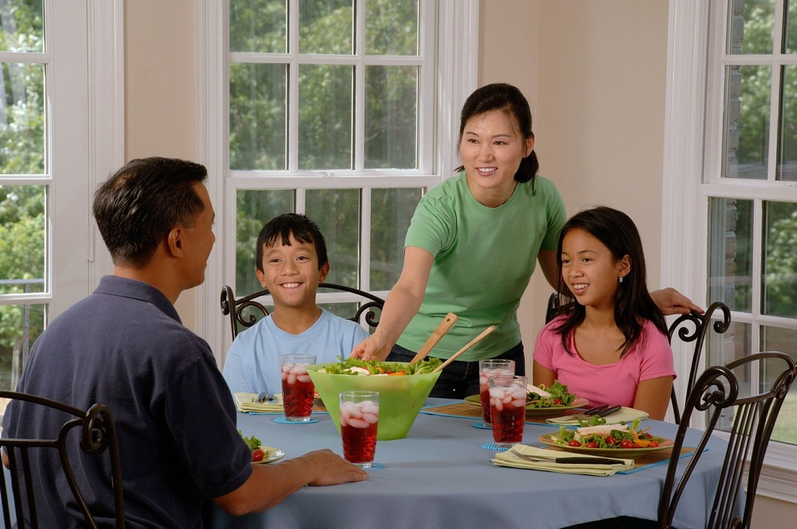
What Do Families Do?
Families cook and share meal times together.

Slide 13
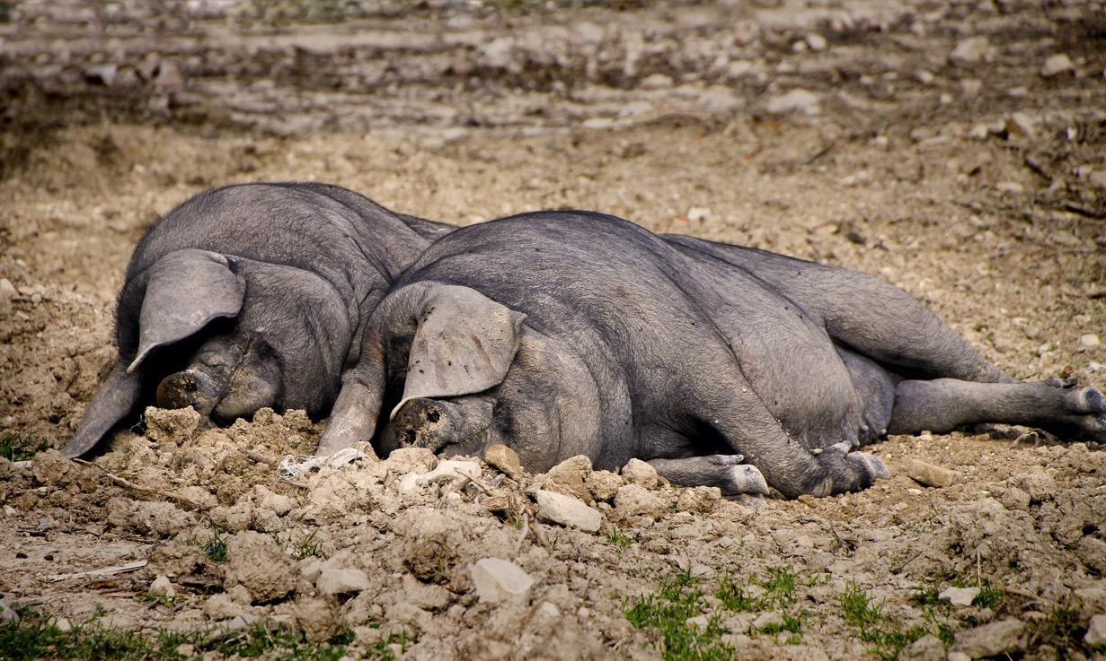
What Do Families Do?
Families rest and relax together.

Slide 14
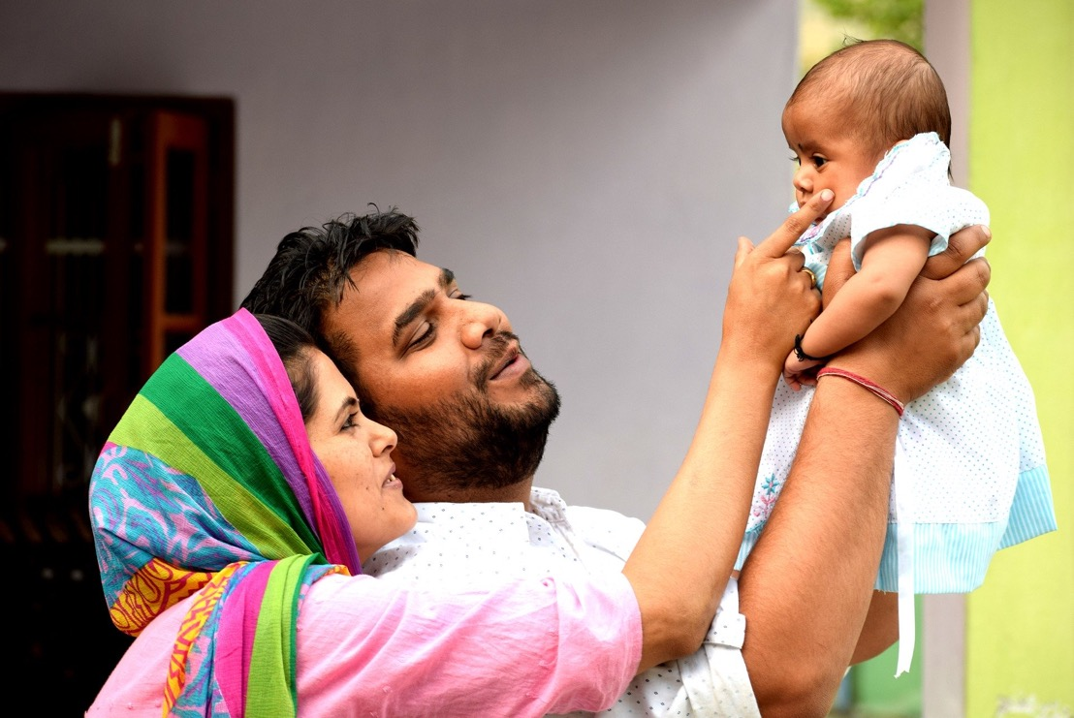
What Do Families Do?
Families make happy memories together.

Slide 15
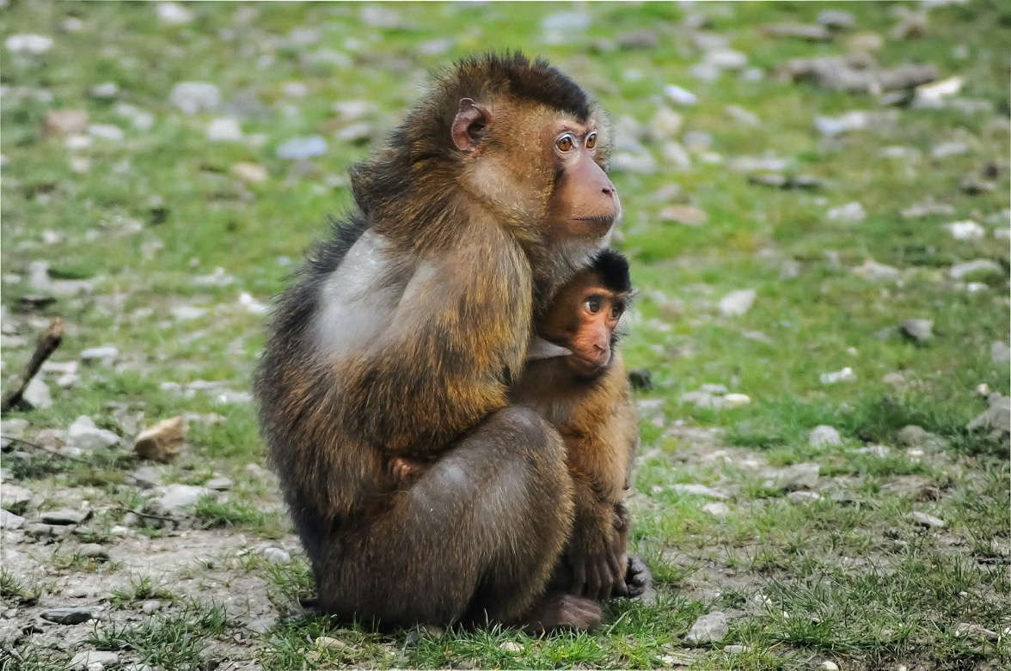
What Do Families Do?
Family members look after each other.

Slide 16
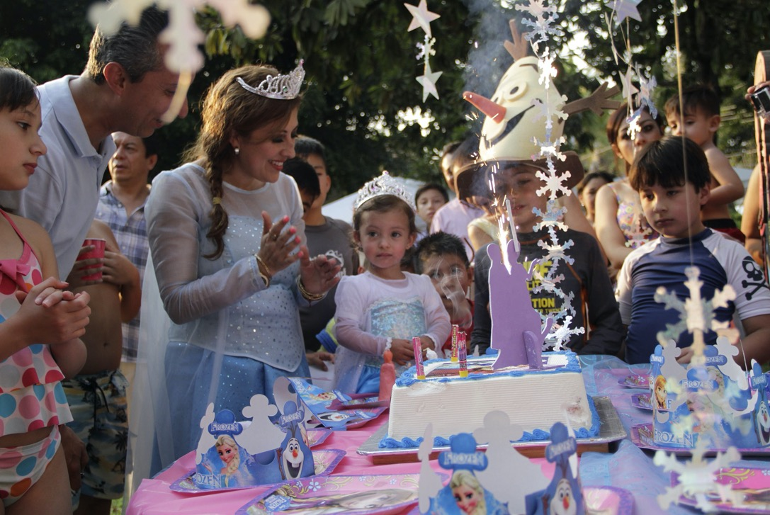
What Do Families Do?
Families celebrate special occasions together.

Slide 17

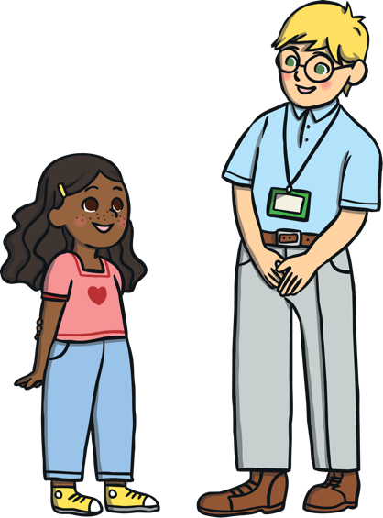
Good Times and Bad Times
There are so many fun, happy things to do and share with our families.
Sometimes though, families go through tough times together.
It’s important to look after each other when something difficult or sad happens.
Sometimes, we need to talk to someone who isn’t in our family and ask for help when something about our families is upsetting or worrying us.
Let’s meet some children who are going through some difficult times.
You can talk to your talk partner about what you think they should do.

Slide 18
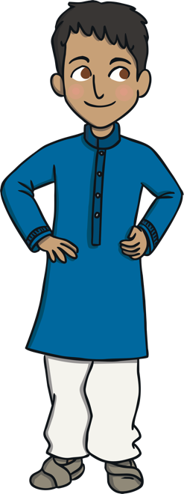

Good Times and Bad Times
Mourib is worried about his mum. She has been poorly for quite a long time and has had lots of appointments at the hospital recently.
She isn’t able to do many jobs at home now and there is no other grown-up living with him, his mum and his sister. Nan sometimes comes round to help when she’s not working.
Who could Mourib talk to about his concerns

Slide 19

Good Times and Bad Times
Florence is finding it really stressful at home. She almost dreads the end of the school day.
At home, Florence’s parents are arguing a lot. They get very angry, shout at each other and slam doors. Florence hides in her room most of the time. Sometimes she gets shouted at too.
Is there anyone Florence could talk to about how difficult things are at home

Slide 20
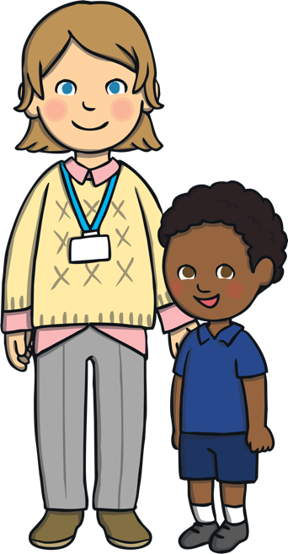
Good Times and Bad Times
It’s important to know that there is always someone to talk to outside of your family if you have any worries or concerns about your family.
Adults at school are good people to talk to and can help if anything about your family is making you unhappy or worried.

Slide 21
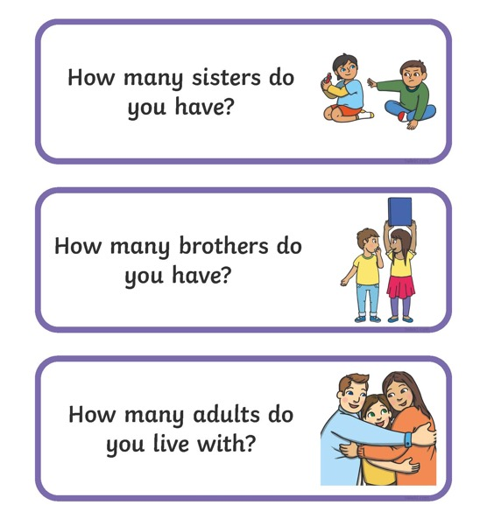
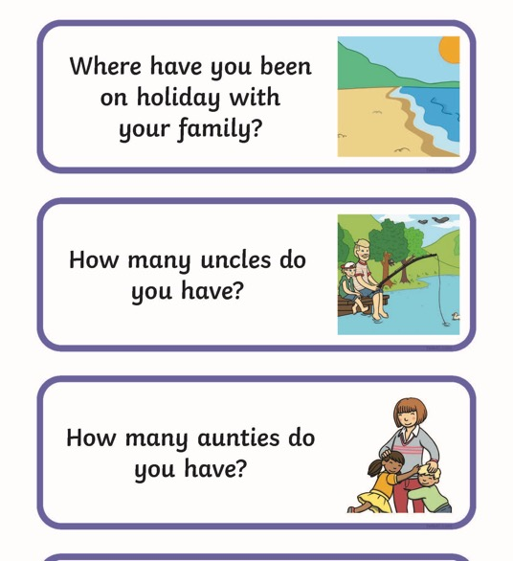
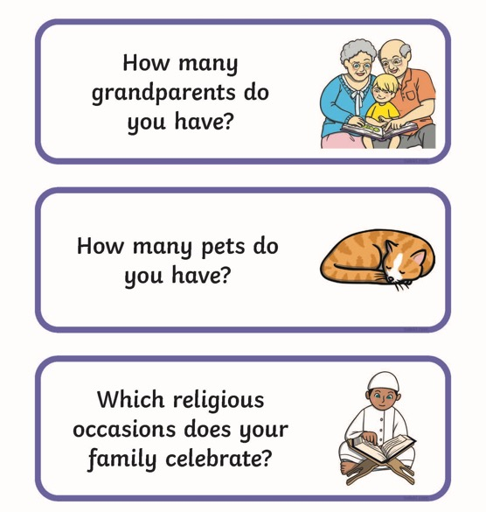
Same or Different?
Read the questions on the cards with your talk partner and if your answer is the same, put them in one pile. If your answer is different, put the card in another pile.
Let’s see how many similarities and differences there are.
It’s time to play a game with the Same or Different Cards!

Slide 22
What is a family and what makes families special?
Who can I talk to if something about my family is worrying me?

